Slide 1
Groundwater Scheme Analysis
Source: https://www.data.gov.in/
NAME: M.kavya
Roll no: 2211cs010344
LinkedIn :https://www.linkedin.com/in/majjarla-kavya-91b9002ba/

Slide 2
Introduction
Introduction
This presentation provides an analysis of the groundwater scheme dataset, covering:
Geographical distribution of schemes
Types of tubewells and their usage
Ownership and financial aspects of schemes
Water distribution methods and energy sources
Key insights and conclusions

Slide 3
Initial Analysis of the Dataset
Initial Analysis of the Dataset
Dataset Overview:
The dataset contains 1,871 rows and 61 columns.
It records groundwater schemes across various states, districts, and villages.
Some columns have missing values, particularly in ownership and operational details.
The data types include text (categorical) and numerical values.
Key Analysis:
State, District, Village: Identifies the location of the scheme.
Scheme Type, Tubewell Type: Describes the type of groundwater scheme.
Ownership & Finance: Includes ownership details, subsidies, and financial sources.
Pumping & Utilization: Details about water distribution, lifting devices, and power sources.
Scheme Status: Indicates whether a scheme is functional, underutilized, or non-operational.

Slide 4
Types of Groundwater Schemes
💧 Tube Wells • Deep or Shallow Wells: These wells extract water from underground aquifers, commonly used in irrigation and drinking water supply. • Efficient Water Extraction: Equipped with pumps, they provide a steady water supply. • Used in Agriculture & Domestic Supply: Frequently used by farmers and rural households.
💧 Dug Wells • Shallow Water Sources: Typically wider but not as deep, relying on groundwater seepage. • Lower Cost: Constructed using local materials, making them cost-effective. • Used for Small-Scale Irrigation & Drinking Water: Often found in villages and semi-urban areas.
💧 Recharge Wells • Groundwater Replenishment: Designed to recharge depleted aquifers by collecting rainwater. • Reduces Water Scarcity: Helps in sustainable water management. • Used in Drought-Prone Areas: A key measure in water conservation efforts.

Slide 5
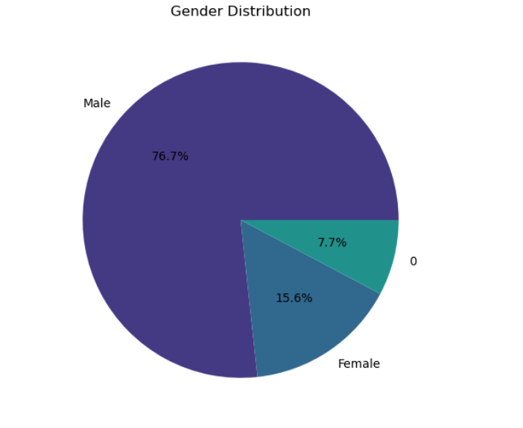
Gender Distribution Overview
The gender distribution chart shows 76.7% male, 15.6% female, and 7.7% unspecified (labeled as 0). This highlights a noticeable gender imbalance in the dataset.

Slide 6
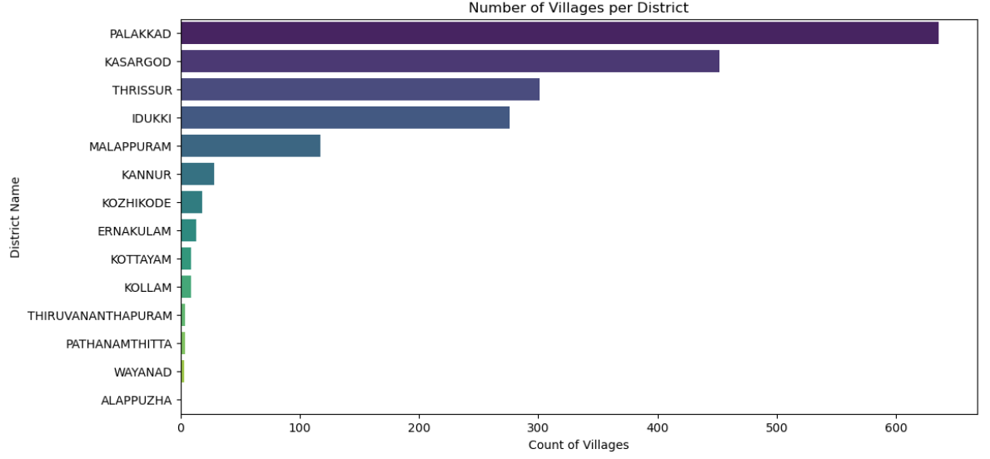
Village Distribution by District
Palakkad has the highest number of villages, followed by Kasargod, Thrissur, and Idukki, while Alappuzha has the least.

Slide 7
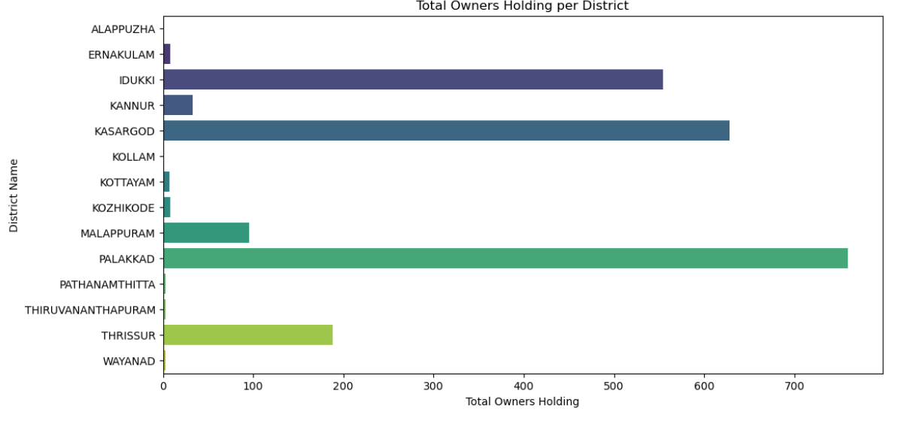
Land Ownership Distribution by District
Palakkad has the highest number of landowners, followed by Kasargod and Idukki, while Alappuzha has the lowest.

Slide 8
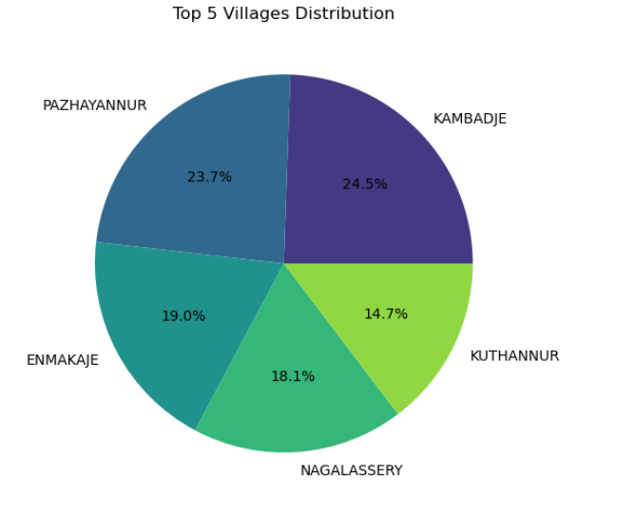
Top 5 Villages Distribution
Kambadje has the highest share, followed by Pazhayannur, while Kuthannur has the lowest among the top five villages.

Slide 9
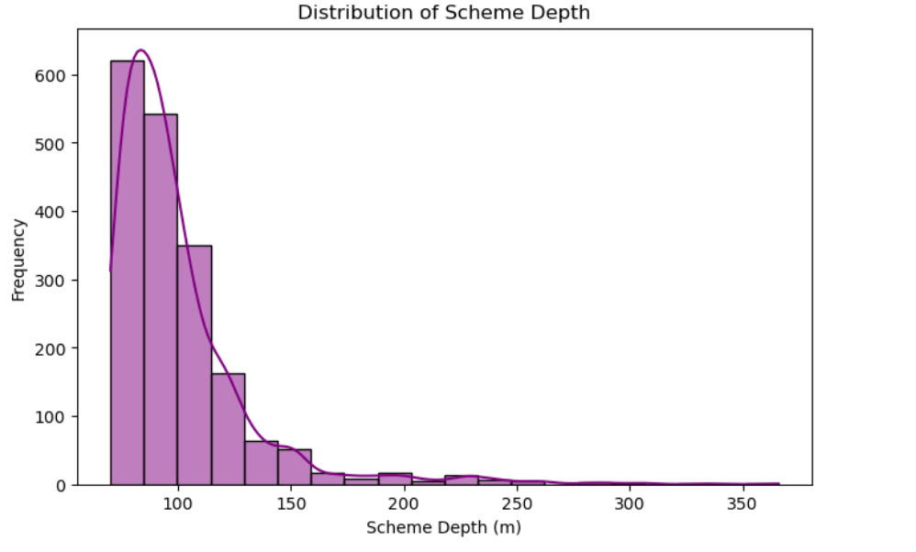
Distribution of Scheme Depth
Most schemes have a depth between 75-125 meters, with frequency decreasing as depth increases.

Slide 10
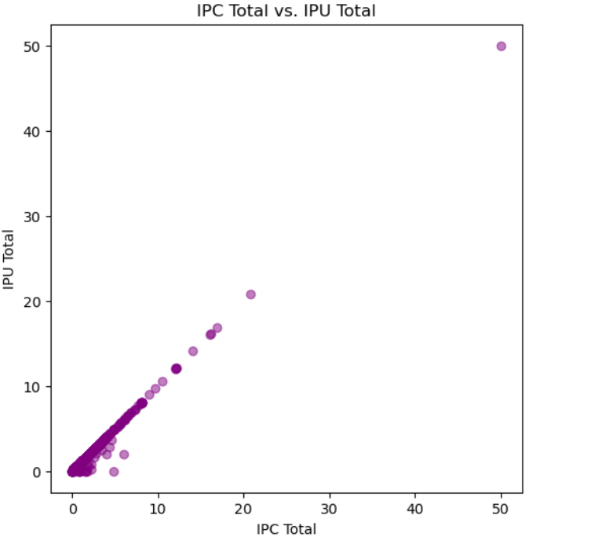
Scatter Plot of IPC vs. IPU
The scatter plot shows the relationship between IPC Total and IPU Total, with most data points clustered near the origin and a few outliers at higher values.

Slide 11
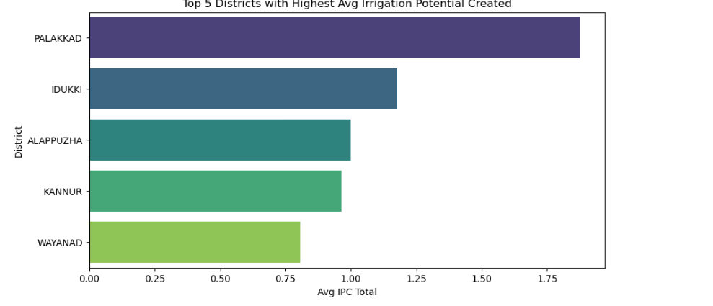
Top Districts in Irrigation Potential
The bar chart displays the top five districts with the highest average irrigation potential created, with Palakkad leading the list.

Slide 12
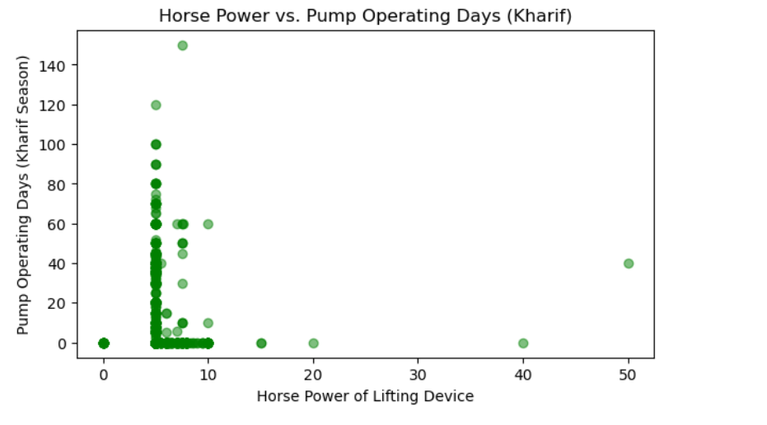
Horse Power vs. Pump Usage in Kharif Season
The scatter plot illustrates the relationship between the horsepower of lifting devices and the number of pump operating days, with most points clustered at lower horsepower values.

